Slide 1
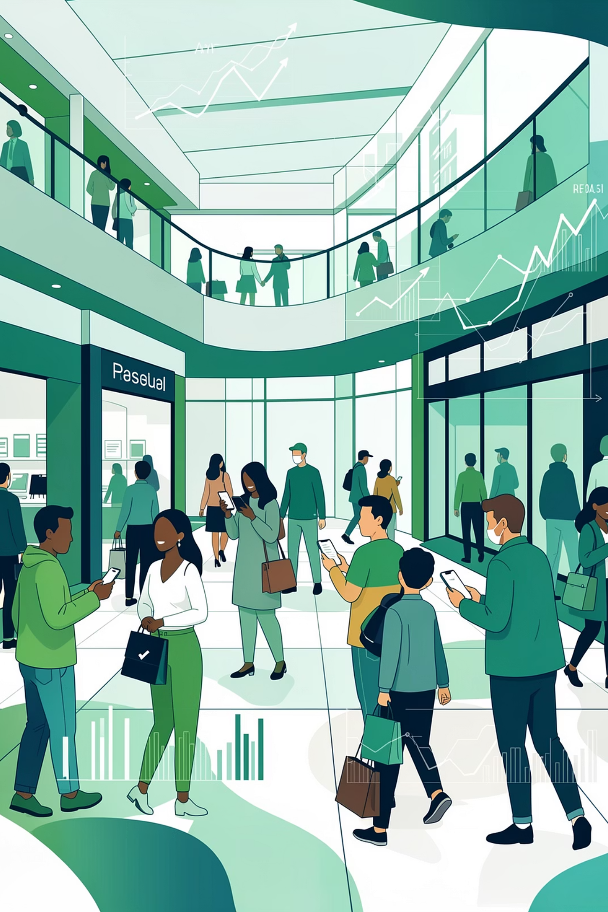
Understanding Customer Shopping Behavior
How can the company leverage consumer shopping data to identify trends, improve engagement, and optimize marketing & product strategies?

Slide 2

Project Scope & Goals
Objective
Outcomes
Deliverables
Analyze purchase patterns across demographics, categories, and channels to inform strategy.
Actionable segments, drivers of repeat purchases, dashboard for stakeholders.
Data prep & modeling (Python), SQL analysis, Power BI visuals, report, Git repo.

Slide 3

Data Preparation & Modeling (Python)
Clean, normalize, and enrich raw data: handle missing values, standardize product/category hierarchies, parse timestamps, and engineer features (recency, frequency, monetary, promo exposure, review sentiment, payment method flags).
Modeling: build customer-level RFM, churn probabilities, and propensity models for repeat purchase and channel preference.

Slide 4
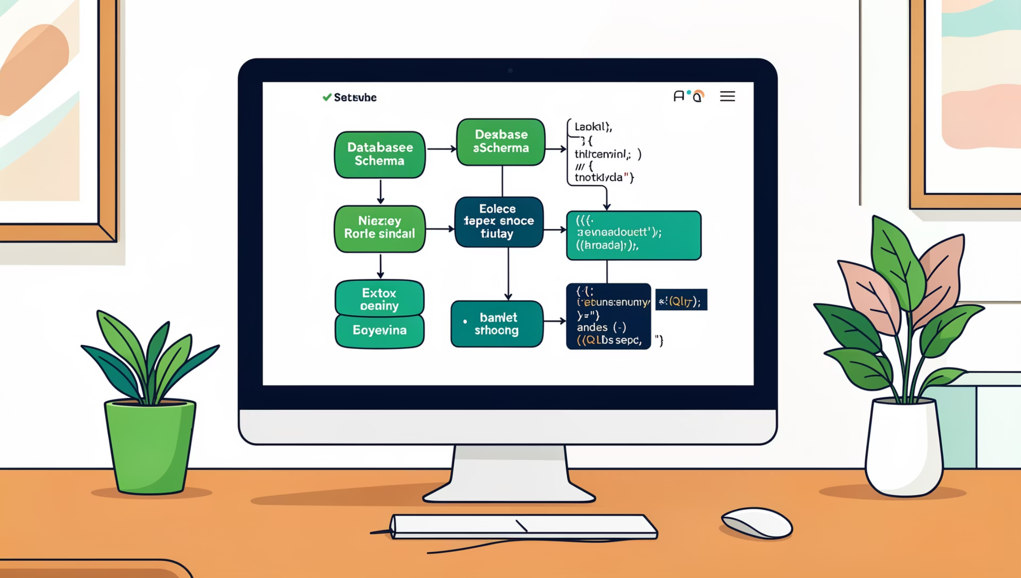
Data Organization & SQL Analysis
Design star schema: customers, transactions, products, reviews, promotions, channels. Simulate transactions where needed and run queries to identify high-value segments, common purchase sequences, and promotion lift.

Slide 5

Key Analyses to Run (SQL)
Customer Segmentation
Purchase Drivers
Channel Comparison
Effect of discounts, reviews, seasonality, and payment methods on conversion & repeat rate.
Online vs. offline performance, cross-channel migration, and basket differences.
RFM cohorts, lifetime value deciles, demographic overlays.

Slide 6
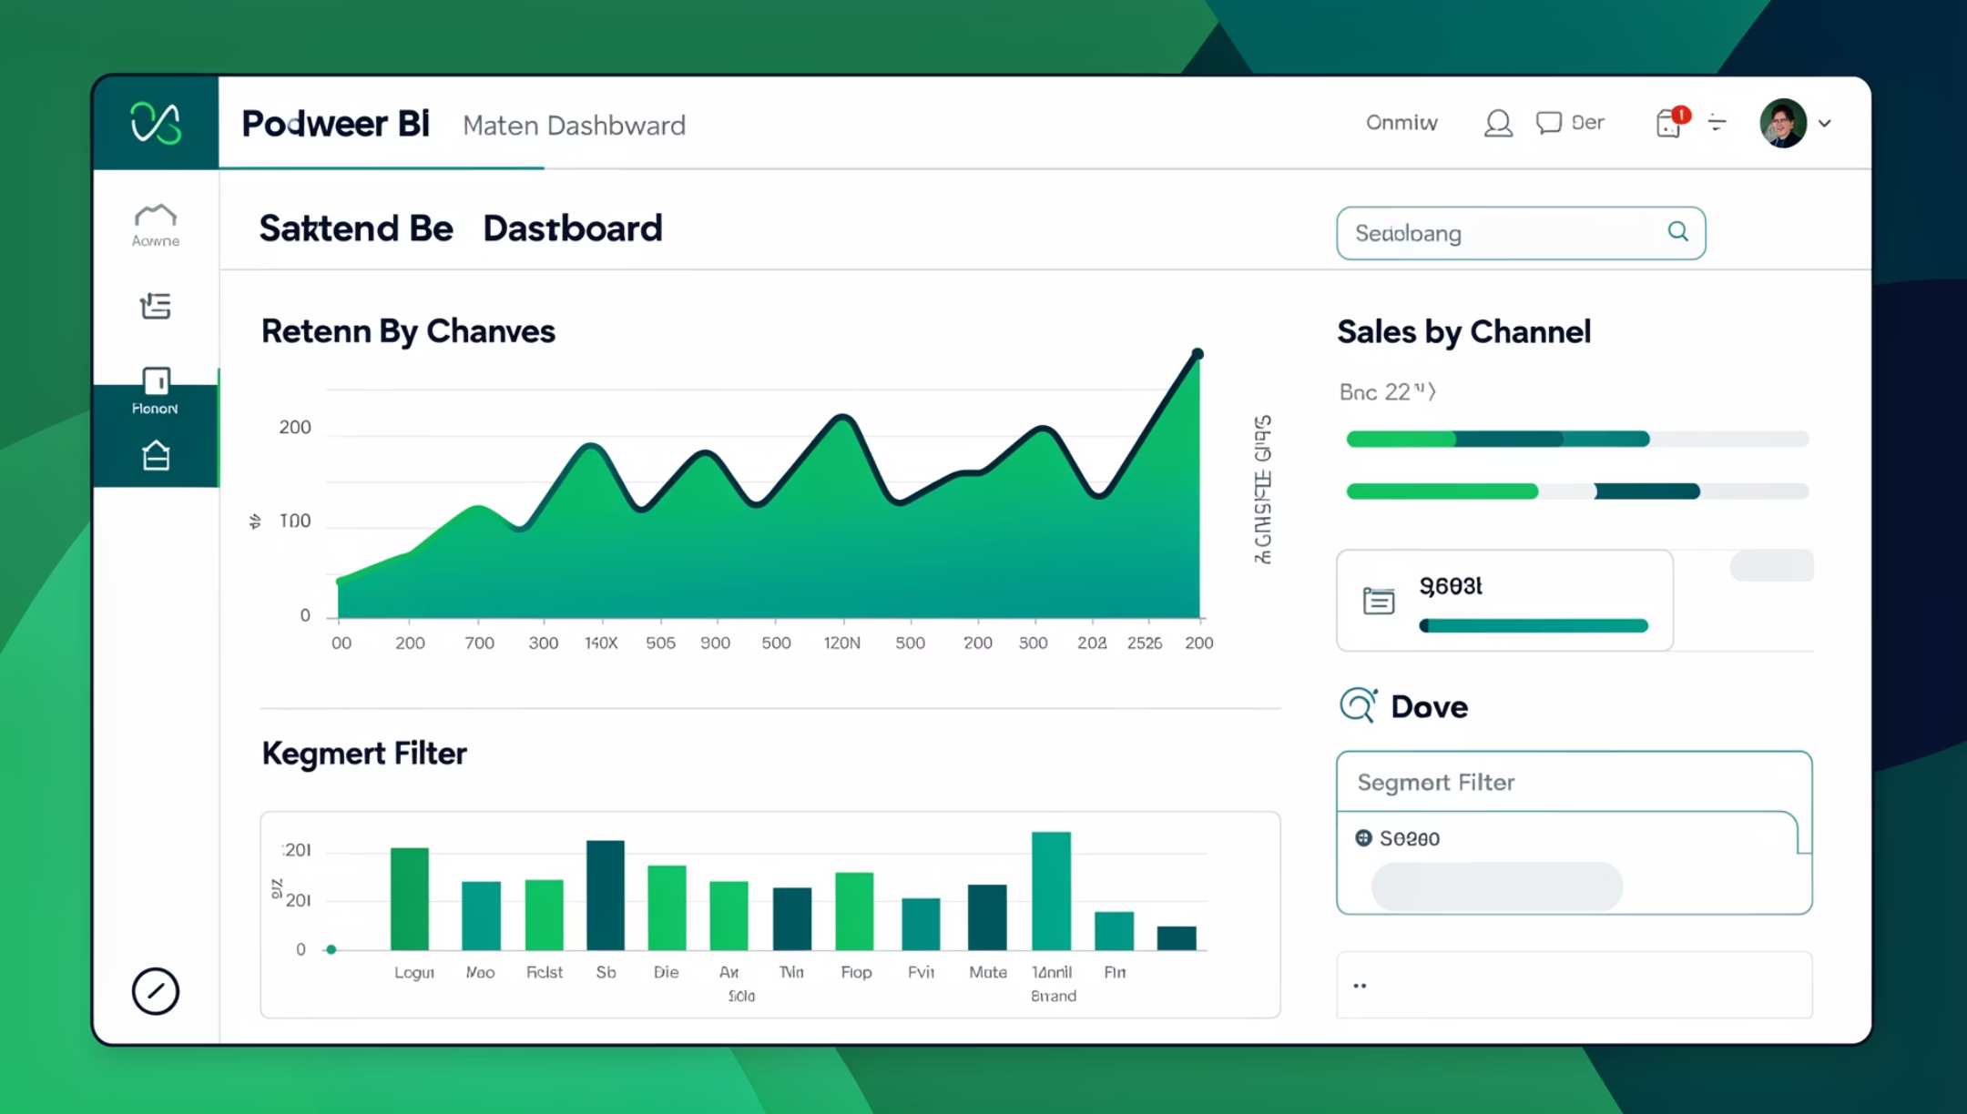
Visualization & Dashboard Strategy (Power BI)
Design Principles
Interactive, filterable views: segments, time-series trends, channel KPIs, promo lift, cohort retention curves.

Slide 7



Insights to Surface
Top Drivers
Seasonality
Channel Behavior
Discounts and positive reviews strongly correlate with conversion; payment convenience increases repeat rate.
Clear seasonal spikes by category; targeted promotions timed to seasonality improve margin-aware sales.
Online baskets are larger for subscriptions and repeat buyers; offline favors impulse categories.

Slide 8
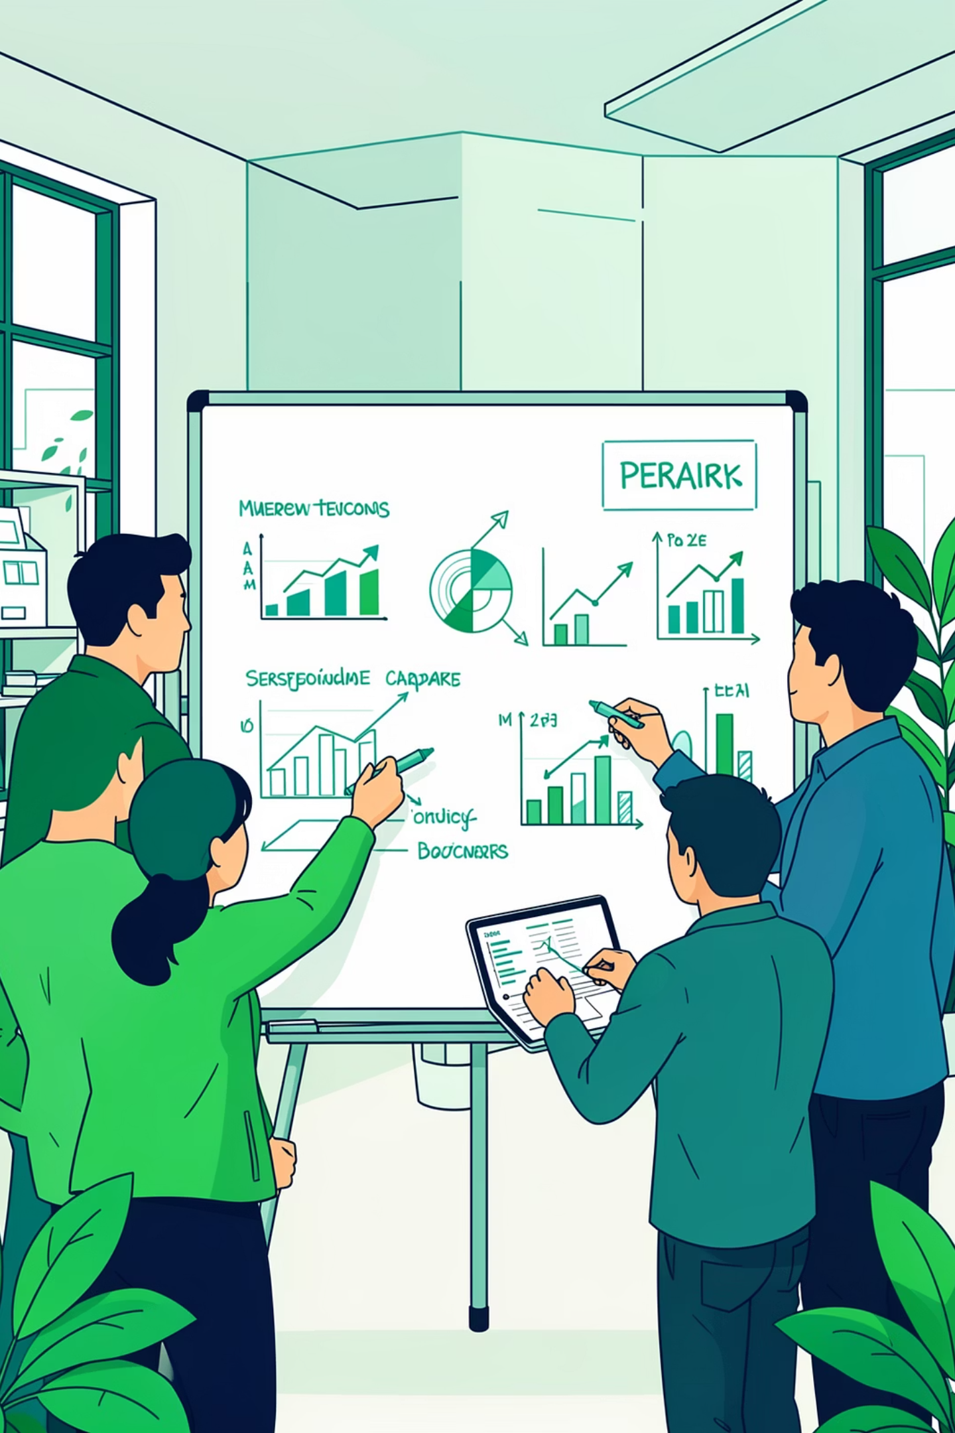
Recommendations — Marketing & Product
1. Personalize Promotions
Target RFM-based cohorts with tailored discounts and review-driven product recommendations.
2. Optimize Channels
Invest in online UX for high-LTV segments and create in-store experiences for impulse categories.
3. Improve Retention
Use payment convenience and subscription offers to raise repeat purchase propensity.

Slide 9
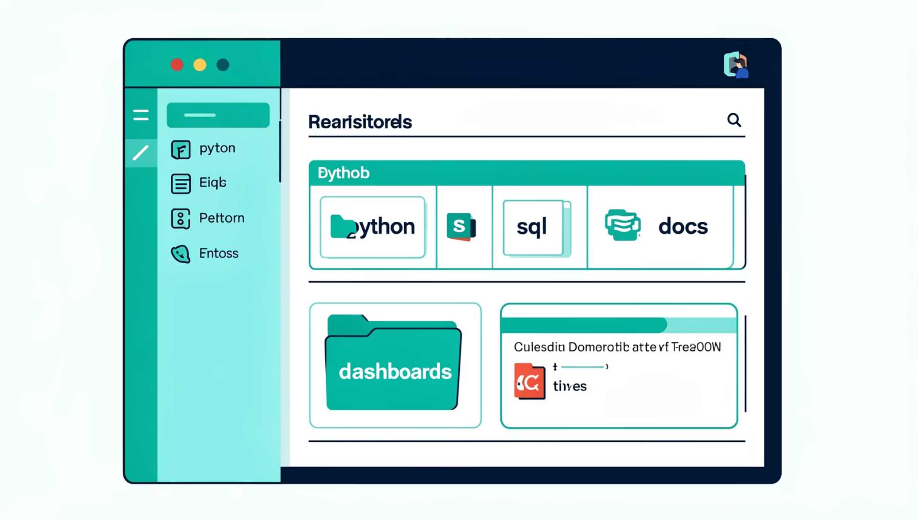
Operational Roadmap & GitHub
Phase 1: Data cleanup, schema, feature engineering (Python)
Phase 2: SQL analyses & segmentation queries
Phase 3: Power BI dashboard build and stakeholder testing
Phase 4: Deploy models, monitor KPIs, iterate
All scripts, queries, and dashboard files will be organized in a public GitHub repository for reproducibility.

Slide 10

Executive Summary & Next Steps
Summary
Immediate Next Steps
Data-driven segmentation and analysis will reveal purchase drivers—discounts, reviews, seasonality, payment preferences—and enable targeted actions to boost sales and loyalty.
Initiate data prep, run core SQL analyses, prototype Power BI dashboard, and prioritize quick-win personalized campaigns.
Stakeholder Ask
Approve access to raw data sources and cross-functional time to validate segment definitions and pilot campaigns.

